Slide 1


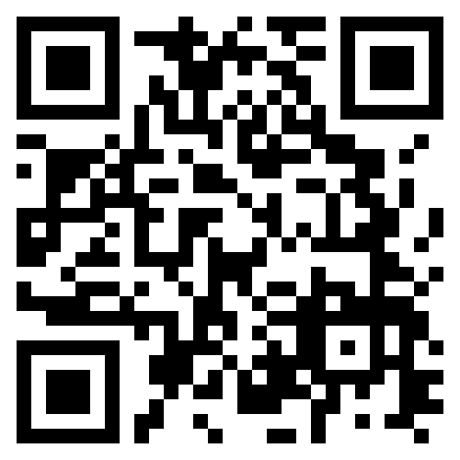
Book your FREE
model aircraft flying lesson
Enjoy a relaxed trial flying session at our Coleshill flying site with the help of our club instructors
A British Model Flying Association Affiliated Club
http://mgmfc.bmfa.club

